Slide 1
UNIT-I
M 1 Introduction to Algorithms
DESIGN AND ANALYSIS OF ALGORITHMS
M Yogi Reddy
Assistant Professor,
Dept. of CSE,
School Of Technology,
GITAM(Deemed to be ) University,
Hyderabad.
Yogi Reddy M, Asst. Prof

Slide 2
Agenda
Algorithm specification
Performance Analysis
Divide and Conquer:
  The general method
  Binary search,
  finding maximum and minimum,
  Merge sort,
  Quick sort,
  Selection sort,
  Strassen’s Matrix multiplication.
Yogi Reddy M, Asst. Prof

Slide 3
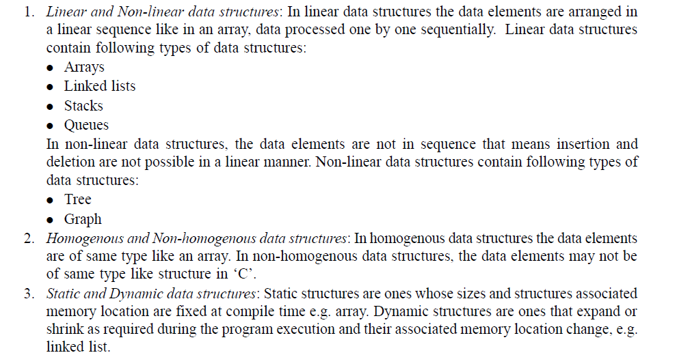
Basic Data Structures concepts
Yogi Reddy M, Asst. Prof

Slide 4
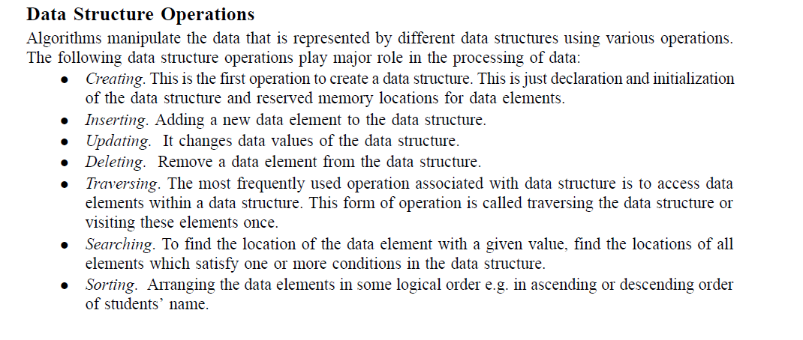
Yogi Reddy M, Asst. Prof

Slide 5
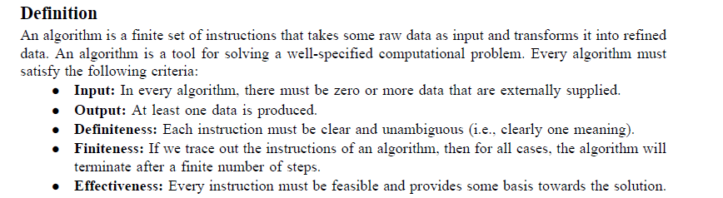
What is an Algorithm?
Yogi Reddy M, Asst. Prof

Slide 6
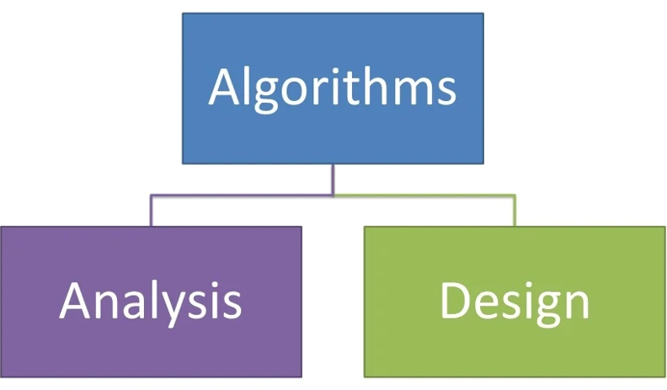
(OR)
An algorithm is a set of steps of operations to solve a problem performing calculation, data processing, and automated reasoning tasks. An algorithm is the best way to represent the solution of a particular problem in a very simple and efficient way.
Yogi Reddy M, Asst. Prof

Slide 7
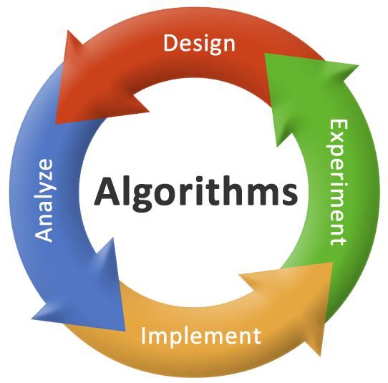
Analysis: predict the cost of an algorithm in terms of resources and performance
Design: creating an efficient algorithm to solve a problem in an efficient way using minimum time and space.
Yogi Reddy M, Asst. Prof

Slide 8
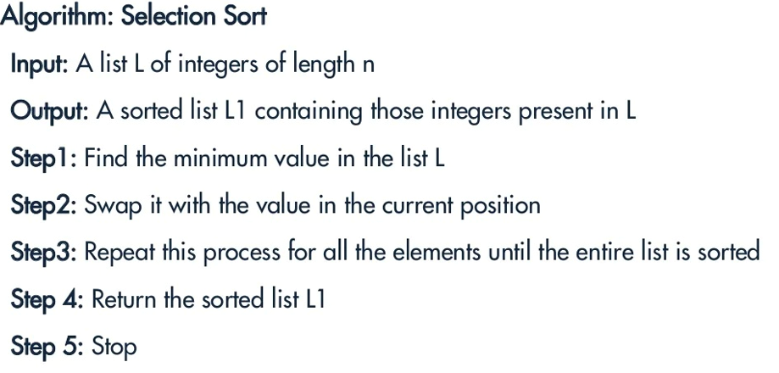
Algorithm vs Pseudocode
An algorithm is a formal definition with some specific characteristics that describes a process. Generally, the word "algorithm" can be used to describe any high level task in computer science.
Yogi Reddy M, Asst. Prof

Slide 9
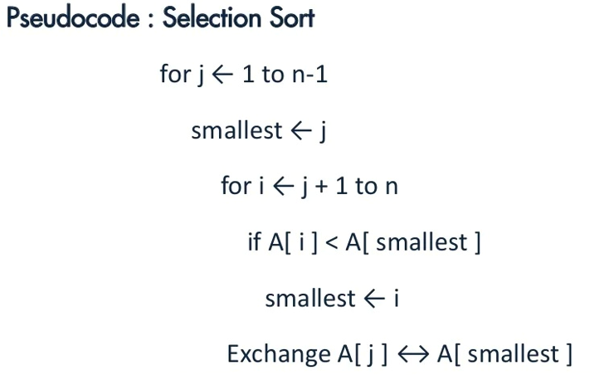
Pseudocode is an informal and human readable description of an algorithm leaving many details of it. Writing a pseudocode has no restriction of styles and its only objective is to describe the high level steps of algorithm.
Yogi Reddy M, Asst. Prof

Slide 10
DAA using Programming languages
All algorithms can be coded using any programming language such as
  C,
  Python,
  C++,
  Java,
  PHP,
  JavaScript,
  C#,
  Etc…..
Yogi Reddy M, Asst. Prof

Slide 11
Algorithm
Definition
An algorithm is a finite set of instructions that accomplishes a particular task.
All algorithms must satisfy the following criteria:
  Input : Zero or more quantities are
  externally supplied.
  2. Output : At least one quantity is produced.
  3. Definiteness : Each instruction is clear and unambiguous.
  Statements such as “add 6 or 7 to x” or “Compute 5/0” are not permitted”
Yogi Reddy M, Asst. Prof

Slide 12
  4. Finiteness : The algorithm should terminate
  after a finite number of steps.
  5. Effectiveness: Instruction is basic
  enough to be carried out.
Yogi Reddy M, Asst. Prof

Slide 13
Pseudo code for expressing algorithms
We present most of our algorithms using pseudo code that resembles C and Pascal.
  Comments begin with // and continue until end of the line.
  Blocks are indicated with matching braces: { and }.
      A compound statement
      Body of a procedure.
  3.
    i. An identifier begins with a letter.
    ii. The data types of variables are not explicitly declared.
    iii. The types will be clear from the context.
    iv. Whether a variable is global or local to a procedure will also be evident from the context.
    v. We assume simple data types such as integer, float, char, boolean, and so on.
    vi. Compound data types can be formed with records.
Yogi Reddy M, Asst. Prof

Slide 14
node = record
{
datatype_1 data_1;
:
datatype_n data_n;
node *link
}
data items of a record can be accessed
with → and period( . )
C style :-
struct node
{
datatype_1 data_1;
:
datatype_n data_n;
struct node *link
}
Yogi Reddy M, Asst. Prof

Slide 15
  4. Assignment of values to variables is done using the assignment statement.
  < variable > := < expression >
  5. There are two boolean values true and false. To produce these values, logical operators and, or and not and the relational operators <, ≤,=, ≠, ≥ and > are provided.
  6. Elements of multidimensional arrays are accessed using [ and ]. For example the (i,j)th element of the array A is denoted as A[i,j].
  7. The following looping statements are used: for, while, and repeat until.
Yogi Reddy M, Asst. Prof

Slide 16
The general form of a while loop:
while( condition ) do
{
statement_1;
:
statement_n;
}
Yogi Reddy M, Asst. Prof

Slide 17
The general form of a for loop:
for variable := value1 to value2 step step do
  Here value1, value2, and step are arithmetic expressions.
  The clause “step step” is optional and taken as +1 if it does not occur.
  step could be either positive or negative.
  variable is tested for termination at the start of each iteration.
Yogi Reddy M, Asst. Prof

Slide 18
  The for loop can be implemented as a
  while loop as follows:
  variable:=value1;
  incr:=step;
  while( ( variable – value2)*step ≤ 0) do
  {
  <statement 1>
  :
  <statement n>
  variable :=variable+incr;
  }
Yogi Reddy M, Asst. Prof

Slide 19
The general form of a repeat-until loop:
  repeat
  <statement 1>
  :
  <statement n>
  until ( condition )
  The statements are executed as long as
  condition is false.
Yogi Reddy M, Asst. Prof

Slide 20
  8. A conditional statement has the following
  forms:
  if < condition > then < statement >
  if < condition > then
  < statement 1>
  else
  < statement 2>
  9. Input and output are done using the instructions read and write.
  Ex: read n;
  write n;
Yogi Reddy M, Asst. Prof

Slide 21
10. Procedure or function starts with the word
Algorithm.
General form :
Algorithm Name( <parameter list> )
{
body
}
where Name is the name of the procedure.
  Simple variables to procedures are passed by value.
  Arrays and records are passed by reference
Yogi Reddy M, Asst. Prof

Slide 22
Ex:-Algorithm that finds and returns the maximum of n given numbers
Algorithm max(a,n)
// a is an array of size n
{
Result:=a[1];
for i:=2 to n do
if a[i]>Result then Result:=a[i];
return Result;
}
Yogi Reddy M, Asst. Prof

Slide 23
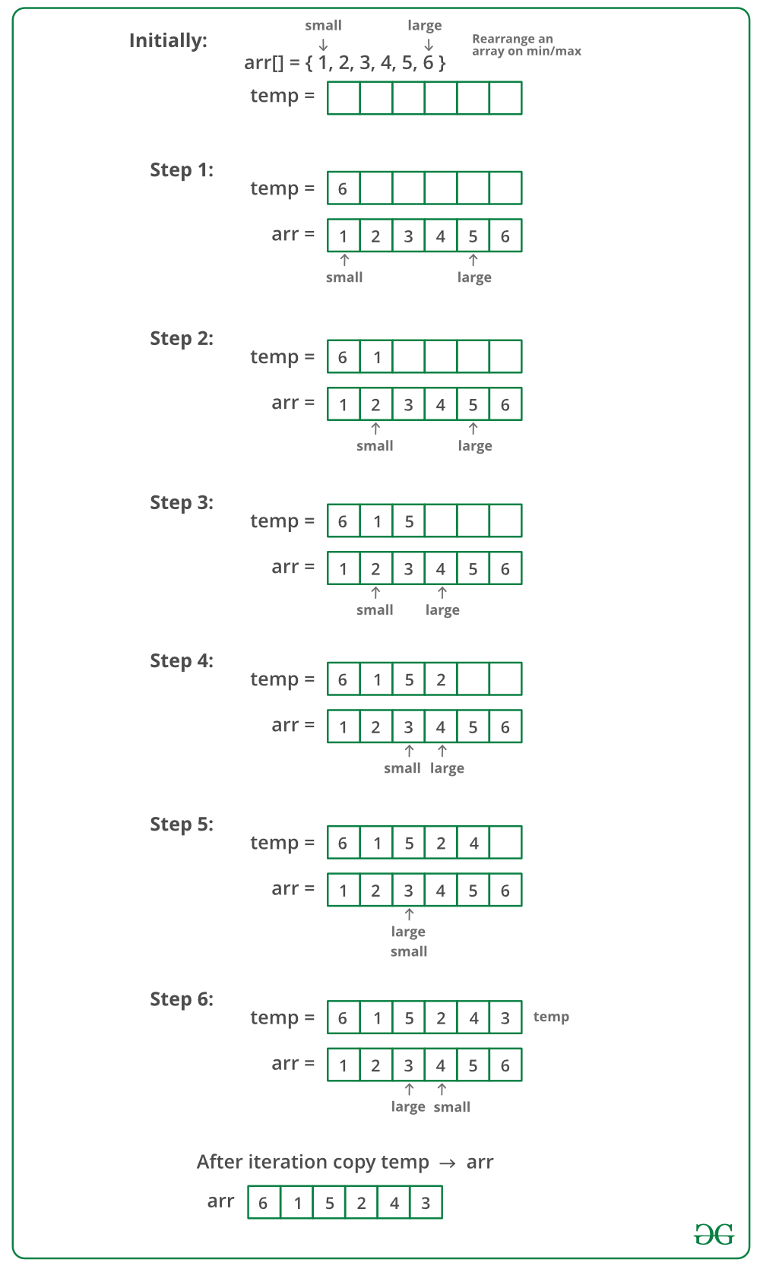
Process for above example
Yogi Reddy M, Asst. Prof

Slide 24
Ex:-Write an algorithm to sort an array of n integers using bubble sort.
Algorithm BubbleSort(a,n)
// a is an array of size n
{
for i:=1 to n-1 do
{
for j:=1 to n-i do
{
if( a[j] >a[j+1] ) then
t=:a[j];
a[j]:=a[j+1];
a[j]:=t;
}
}
}
Yogi Reddy M, Asst. Prof

Slide 25
Performance Analysis
(machine independent)
There are many things upon which the performance will depend.
  Does the program efficiently use primary and Secondary storage?
  Is the program's running Time acceptable for the task?
  Does it do what we want it to do?
  Does it work correctly according to the specifications of the task?
  Does the program contain documentation that shows how to use it and how it works?
  Is the program's code readable?
Yogi Reddy M, Asst. Prof

Slide 26
Practice Practice Practice
How to achieve them?
  Good programming style, experience, and practice
  Discuss and think.
Think
Think
Think
Yogi Reddy M, Asst. Prof

Slide 27
There are other criteria for judging algorithms that have a more direct relationship to performance.
  1. Space Complexity: The space complexity of an algorithm is the amount of memory it needs to run to completion. Therefore, the space requirement of any problem P can be written as S(P) = C +S_{p}( Instance characteristics(I) )
  2. Time Complexity: The time complexity of an algorithm is the amount of computer time it needs to run to completion. Therefore, the time requirement of any problem P can be written as
  T(P)=C+T_{P}( Instance characteristics(I) )
Yogi Reddy M, Asst. Prof

Slide 28
Space Complexity
The space needed by a program has the following components.
  Instruction space
    Instruction space is the space needed to store the compiled version of the program instructions.
    The amount of instruction space that is needed depends on the compiler used to compile the program into machine code.
Yogi Reddy M, Asst. Prof

Slide 29
  Data space
    Data space is the space needed to store all constant and variable values. Data space has two components.
      Space needed by constants( ex; 1 and 2 in max of n num algorithm) and simple variables( such as i, j, n etc).
      Space needed by a dynamically allocated objects such as arrays and class instances.
    Space taken by the variables and constants varies from language to language and platform to platform.
Yogi Reddy M, Asst. Prof

Slide 30
  Environmental stack space
    The environment stack is used to save information needed to resume execution of partially completed functions.
    Each time a function is invoked the following data are saved on the environment stack.
      The return address .
      The values of all local variables and formal parameters in the function being invoked( necessary for recursive functions only).
Yogi Reddy M, Asst. Prof

Slide 31
For example Fact using Recursive algorithm
Algorithm rfactorial(n)
// n is an integer
{ fact=1;
if (n=1 or n=0) return fact;
else
fact=n*rfactorial(n-1);
return fact;
}
Each time the recursive function rfactorial is invoked,
the current values of n and fact and the program location to return to on completion are saved in the environment stack.
Yogi Reddy M, Asst. Prof

Slide 32
Execution
n : 2
R:
n : 3
int rfactorial(n){ //3500
fact=1
if (n=0 or n=1)return fact
else
fact=n*rfactorial(n-1); //4000
return fact;}
int rfactorial(n){
fact=1;
if (n=0 or n=1)return fact;
else
fact=n*rfactorial(n-1);
return fact;
}
void main()
{int R=rfactorial(3);
printf(R);}
int rfactorial(n){ //2500
fact=1;
if (n=0 or n=1)return fact;
else
fact=n*rfactorial(n-1); //3000
return fact;
}
void main()
{int R=rfactorial(3);
printf(R);} //2000
R=6
fact=6
n : 1
n=3
fact=1
R
2000
n=2
fact=1
3000
int rfactorial(n){
if (n=0 or n=1)
return 1;
else
fact=n*rfactorial(n-1);
return fact;
}
4000
fact=2
fact=1
Stack
Yogi Reddy M, Asst. Prof

Slide 33
Summary of space complexity
The space needed by a program depends on several factors.
We cannot make an accurate analysis of the space requirements of a program unless we know the computer or compiler that will be used.
However, we can determine the components that depend on the characteristics of the problem instance (e.x.the number of inputs and outputs or magnitude of the numbers involved ) to be solved.
  Ex:-1. Space requirements of a program that sorts n elements
  can be expressed as a function of n.
  2. Space requirements of a program that adds two m×n
  matrices can be expressed as a function of m, n.
Yogi Reddy M, Asst. Prof

Slide 34
Contd..
  The size of the instruction space is independent of the problem instance to be solved.
  The contribution of the constants and simple variables to the data space is also independent of the problem instance to be solved.
  Most of the dynamically allocated memory( ex., arrays, class instances etc) depends on problem instance to be solved.
  The environmental stack space is generally independent of the problem instance unless recursive functions are in use.
Yogi Reddy M, Asst. Prof

Slide 35
Contd..
  Therefore, We can divide the total space needed by a
  program into two parts:
i) Fixed Space Requirements (C)
Independent of the characteristics ( num, size of inputs and
outputs) of the problem instance ( I )
    instruction space
    space for simple variables and constants.
  ii) Variable Space Requirements (S_{P}(I))
  depend on the characteristics of the problem instance ( I )
    Number of inputs and outputs associated with I
    recursive stack space ( formal parameters, local variables, return address ).
  Therefore, the space requirement of any problem P can be written as
  S(p)=C +S_{p}( Instance characteristics )
Yogi Reddy M, Asst. Prof

Slide 36
Note:
  When analyzing the space complexity of an algorithm, we concentrate only on estimating
  S_{p} (Instance characteristics ).
  We do not concentrate on estimating fixed part c .
  We need to identify the instance characteristics of the problem to measure S_{p}
Yogi Reddy M, Asst. Prof

Slide 37
Example1
Algorithm abc(a,b,c)
{
return a+b+b*c+(a+b-c)/(a+b)+4.0;
}
Problem instance characterized by the specific values of a,b,and c.
If we assume one word (4 bytes) is adequate to store the values of each a, b, and c , then the space needed by abc is independent of the instance characteristics.
Therefore, S_{abc}( instance characteristics)=0
Yogi Reddy M, Asst. Prof

Slide 38
Example2
Algorithm sum(a,n)
{
s:=0;
for i:=1 to n do
s:=s+a[i];
return s;
}
Problem instance characterized by n.
The amount of space needed by n is one word, since n is integer.
The space needed by a is the space needed by the variables of type array of floating point numbers.
It is atleast n words, since a must be large enough to hold the n elements to be summed.
Therefore, S_{sum}(n) = n+3
Yogi Reddy M, Asst. Prof

Slide 39
Example3
Algorithm RSum(a,n)
{
if(n ≤ 0) then return 0;
else return RSum(a,n-1)+a[n];
}
Type | Name | Number of bytes
formal parameter: int | a | 2
formal parameter: int | n | 2
return address ( used internally) |  | 2
Total per one recursive call |  | 6
Total no.of recursive calls n, therefore S_{RSum} (n)=6(n+1)
Yogi Reddy M, Asst. Prof

Slide 40
Time Complexity
T(P)=C+T_{P}(I)
  The time, T(P), taken by a program, P, is the sum of its compile time C and its run (or execution) time, T_{P}(I).
  The compile time does not depend on the instance characteristics.
  We will concentrate on estimating run time T_{p}(I).
Yogi Reddy M, Asst. Prof

Slide 41
If we know the characteristics of the compiler to be used, we can determine the
  No. of additions , subtractions, multiplications, divisions, compares, and so on.
Then we can obtain an expression for T_{p}(n) Of the form
  T_{P}(n)=c_{a}ADD(n)+ c_{s}SUB(n)+ c_{m} MUL(n)+ c_{d} DIV(n)+……..
  where,
  n denotes the instance characteristics.
  c_{a}, c_{s}, c_{m}, c_{d} and so on denote the time needed for an addition , subtraction, multiplication, division and so on. And
  ADD, SUB, MUL, DIV, and so on are functions whose values are the no.of additions, subtractions, multiplications, divisions, and so on.
Yogi Reddy M, Asst. Prof

Slide 42
Obtaining such an exact formula is an impossible task, since time needed for an addition, subtraction, and so on, depends an numbers being added, subtracted, and so on.
The value of Tp(n) for any given n can be obtained only experimentally.
Even with the experimental approach, one could face difficulties.
In a multi user system the execution time of a program p depends on the number of other programs running on the computer at the time program p is running.
Yogi Reddy M, Asst. Prof

Slide 43
Contd..
As there were some problems in determining the execution time using earlier methods, we will go one step further and count only the number of program steps.
program step
program step is loosely defined as a syntactically or semantically meaningful program segment whose execution time is independent of the instance characteristics.
  Example
  result = a + b + b * c + (a + b - c) / (a + b) + 4.0;
  sum = a + b + c;
Yogi Reddy M, Asst. Prof

Slide 44
The number of steps assigned to any program statement depends on the kind of statement.
Comments are counted as zero number of steps.
An assignment statement which does not involve any calls to other functions counted as one step.
Loops, such as the for, while, and repeat-until, we consider the step counts only for the control part of the statement.
The control parts for for and while statements have the following forms:
  for i:= <expr1> to <expr2> do
  while ( <expr> ) do
Yogi Reddy M, Asst. Prof

Slide 45
Each execution of the control part of a while statement is one, unless <expr> is a function of instance characteristics.
The step count for each execution of the control part of a for statement is one, unless <expr1> and <expr2> are functions of the instance characteristics.
The step count for each execution of the condition of a conditional statements is one, unless condition is a function of instance characteristics.
If any statement ( assignment statement, control part, condition etc.) involves function calls, then the step count is equal to the number of steps assignable to the function plus one.
Yogi Reddy M, Asst. Prof

Slide 46
Methods to compute the step count
  1) Introduce global variable count into programs with initial value zero.
    Statements to increment count by the appropriate amount are introduced into the program.
    The change in the value of the count by the time this program terminates is the number steps executed by the program.
  2) Tabular method
    Determine the total number of steps contributed by each statement per execution × frequency
    Add up the contribution of all statements
Yogi Reddy M, Asst. Prof

Slide 47
Method-I: Introduce variable count into programs
EX:- Iterative sum of n numbers
Algorithm sum(a, n)
{
s:=0;
  count:=count+1; // for assignment statement
for i:=1 to n do
{ count:=count+1; // For for
s:=s+a[i];
count:=count+1; // for assignment statement
}
count:=count+1; // for last time of for
return s;
count:=count+1; // for return
}
2n + 3 steps
Note : Step count tells us how the run time for a program changes with
changes in the instance characteristics.
Yogi Reddy M, Asst. Prof

Slide 48
Ex:- Addition of two m×n matrices
Algorithm Add(a,b,c,,m,n)
{
  for i:=1 to m do
  {
  for j:=1 to n do
  {
  c[i,j]:=a[i,j]+b[i,j];
  }
  }
  }
2mn + 2m+1 steps
Yogi Reddy M, Asst. Prof

Slide 49
EX:- Recursive sum of n numbers
Algorithm RSum(a,n)
{
count:=count+1; // for the if conditional
if(n ≤ 0) then
{
return 0;
count:=count+1; // for the return
}
else
{
return RSum(a,n-1)+a[n];
count:=count+1; // For the addition, function invocation and return
}
}
Yogi Reddy M, Asst. Prof

Slide 50
When analyzing a recursive program for its step count, we often obtain a recursive formula for the step count.
We obtain the following recursive formula for above (RSum) algorithm.
t_{RSum} (n)=
2
If n=0
2+ t_{RSum}(n-1)
If n>0
Yogi Reddy M, Asst. Prof

Slide 51
One way of solving such recursive formula is by repeated substitutions for each occurrence of the function t_{RSum} on the right side until all such occurrences disappear:
t_{RSum} (n) = 2+t_{RSum}(n-1)
= 2+2+t_{RSum}(n-2)
= 2(2)+t_{RSum}(n-2)
= 2+2+2+_{tRSum}(n-3)
= 2(3)+t_{RSum}(n-3)
:
:
= n(2) +t_{RSum}(n-n)
=2n+t_{RSum}(0)
= 2n+2
The step count for Rsum is 2n+2
Yogi Reddy M, Asst. Prof

Slide 52
Definition : Input size
One of the instance characteristics that is frequently used in the literature is the input size.
The input size of any instance of a problem is defined to be number of words needed to describe that instance.
The input size for the problem of summing and array of n elements is n+1,
where n for listing the n elements and
1 for the value of n.
Yogi Reddy M, Asst. Prof

Slide 53
Method-II: Tabular method
EX:- Iterative sum of n numbers
Statement | s/e | frequency | Total steps
Algorithm sum(a, n) { s:=0 ; for i:=1 to n do s:=s+a[i]; return s; } | 0 0 1 1 1 1 0 | -- -- 1 n+1 n 1 -- | 0 0 1 n+1 n 1 0
Total |  |  | 2n+3
Yogi Reddy M, Asst. Prof

Slide 54
EX:- Addition of two m×n matrices
Statement | s/e | frequency | Total steps
Algorithm Add(a,b,c,m, n) { for i:=1 to m do for j:=1 to n do c[i,j]:=a[i,j]+b[i,j] ; } | 0 0 1 1 1 0 | -- -- m+1 m(n+1) mn -- | 0 0 m+1 mn+m mn 0
Total |  |  | 2mn+2m+1
Yogi Reddy M, Asst. Prof

Slide 55
EX:- Recursive sum of n numbers
Statement | s/e | Frequency n=0 n>0 | Total steps n=0 n>0
Algorithm RSum(a,n) { if( n ≤ 0 ) then return 0; else return Rsum(a,n-1)+a[n] ; } | 0 0 1 1 1+x 0 | -- -- -- -- 1 1 1 0 0 1 -- -- | 0 0 0 0 1 1 1 0 0 1+x 0 0
Total |  |  | 2 2+x
x=t_{RSum}(n-1)
Yogi Reddy M, Asst. Prof

Slide 56
Best, Worst, Average Cases
Not all inputs of a given size take the same number of program steps.
Sequential search for K in an array of n integers:
  Begin at first element in array and look at each element in turn until K is found.
1. Best-Case Step count:-
Minimum number of steps executed by the algorithm for the given parameters.
2. Worst-Case Step count:-
Maximum number of steps executed by the algorithm for the given parameters.
3. Average-Case Step count:-
Average number of steps executed by an algorithm.
Yogi Reddy M, Asst. Prof
Notes:
Best: Find at first position. Cost is 1 compare.
Worst: Find at last position. Cost is n compares.
Average: (n+1)/2 compares IF we assume the element with value K is equally likely to be in any position in the array.

Slide 57
Contd..
5 ms
Worst -case time
Running
Time
4 ms
3 ms
Best-case time
2 ms
1 ms
A
B
C
D
E
F
G
Input
A time + B time+ ………..+G time
Average-case time =
----------------------------------------------------
7 ( total number of possible inputs )
Yogi Reddy M, Asst. Prof

Slide 58
Inexactness of step count.
  Both the instructions x=y; and x=y+z+(x/y) count as one step.
  Therefore, two analysts may arrive at 4n²+6n+2 and 7n²+3n+4 as the step count for the same program.
  Because of the inexactness of what a step count stands for, the exact step count is not very useful for comparison of algorithms.
Yogi Reddy M, Asst. Prof

Slide 59
Asymptotic efficiency
Asymptotic efficiency means study of algorithms efficiency for large inputs.
To compare two algorithms with running times f(n) and g(n), we need a rough measure that characterizes how fast each function grows as n grows.
Hint: use rate of growth
Compare functions asymptotically!
  (i.e., for large values of n)
Yogi Reddy M, Asst. Prof

Slide 60
Rate of Growth
Ex:- f(n)=n²+100n+log₁₀n+1000
n | f(n) | n2 |  | 100n |  | log10n |  | 1000
 | value | value | % | value | % | value | % | value | %
1 | 1,101 | 1 | 0.1 | 100 | 9.1 | 0 | 0.0 | 1,000 | 90.83
10 | 2,101 | 100 | 4.76 | 1,000 | 47.6 | 1 | 0.05 | 1,000 | 47.60
100 | 21,002 | 10,000 | 47.6 | 10,000 | 47.6 | 2 | 0.001 | 1,000 | 4.76
1,000 | 1,101,003 | 1,000,000 | 90.8 | 100,000 | 9.1 | 3 | 0.0003 | 1,000 | 0.09
10,000 | 101,001,004 | 100,000,000 | 99.0 | 1,000,000 | 0.99 | 4 | 0.0 | 1,000 | 0.001
1,00000 | 10,010,001005 | 10,000,000,000 | 99.9 | 10,000,000 | 0.099 | 5 | 0.0 | 1,000 | 0.00
Yogi Reddy M, Asst. Prof

Slide 61
The low order terms and constants in a function are relatively insignificant for large n
n² + 100n + log₁₀n + 1000 ~ n²
i.e., we say that n² + 100n + log₁₀n + 1000 and n² have the same rate of growth
Some more examples
n⁴ + 100n² + 10n + 50 is ~ ?
10n³ + 2n² is ~ ?
n³ - n² is ~ ?
constants
  10 is ~ ?
  1273 is ~ ?
Yogi Reddy M, Asst. Prof

Slide 62

Asymptotic/order Notations
Asymptotic/order notation describes the behavior of functions for the large inputs.
1. Big Oh(O) notation:
  The big oh notation describes an upper bound on the asymptotic growth rate of the function f.
Definition: [Big “oh’’]
  f(n) = O(g(n)) (read as “f of n is big oh of g of n”) iff there exist positive constants c and n₀ such that
  f(n) ≤ cg(n) for all n, n ≥ n₀.
Yogi Reddy M, Asst. Prof

Slide 63
In other words, g(n) grows faster than or same rate as f(n).
Examples
  f(n) = 3n+2
    3n + 2 <= 4n, for all n >= 2, ∴3n + 2 = Ο (n)
  f(n) = 10n²+4n+2
    10n²+4n+2 <= 11n², for all n >= 5, ∴ 10n²+4n+2 = Ο (n²)
  f(n)=6*2^{n}+n²=O(2^{n}) /* 6*2^{n}+n² ≤7*2^{n} for n≥4 */
Yogi Reddy M, Asst. Prof

Slide 64
It also possible to write 10n²+4n+2 = O(n³) since 10n²+4n+2 <=7n³ for n>=2
Although n³ is an upper bound for 10n²+4n+2, it is not a tight upper bound; we can find a smaller function (n²⁾ that satisfies big oh relation.
But, we can not write 10n²+4n+2 =O(n), since it does not satisfy the big oh relation for sufficiently large input.
Yogi Reddy M, Asst. Prof

Slide 65

2. Omega (Ω) notation:
  The omega notation describes a lower bound on the asymptotic growth rate of the function f.
Definition: [Omega]
  f(n) = Ω(g(n)) (read as “f of n is omega of g of n”) iff there exist positive constants c and n₀ such that f(n) ≥ cg(n) for all n, n ≥ n₀.
Yogi Reddy M, Asst. Prof

Slide 66
In other words, f(n) grows faster than or same rate as g(n).
Examples
  f(n) = 3n+2
    3n + 2 >= 3n, for all n >= 1, ∴3n + 2 = Ω (n)
  f(n) = 10n²+4n+2
    10n²+4n+2 >= n², for all n >= 1, ∴ 10n²+4n+2 = Ω (n²)
Yogi Reddy M, Asst. Prof

Slide 67
It also possible to write 10n²+4n+2 = Ω(n) since 10n²+4n+2 >=n for n>=0
Although n is a lower bound for 10n²+4n+2, it is not a tight lower bound; we can find a larger function (n²⁾ that satisfies omega relation.
But, we can not write 10n²+4n+2 = Ω(n³), since it does not satisfy the omega relation for sufficiently large input.
Yogi Reddy M, Asst. Prof

Slide 68

3.Theta (Θ) notation:
  The Theta notation describes a tight bound on the asymptotic growth rate of the function f.
Definition: [Theta]
  f(n) = Θ(g(n)) (read as “f of n is theta of g of n”) iff there exist positive constants c₁, c₂, and n₀ such that c₁g(n) ≤ f(n) ≤ c₂g(n) for all n, n ≥ n₀.
Yogi Reddy M, Asst. Prof

Slide 69
In other words, f(n) grows same rate as g(n).
Examples:-
  f(n) = 3n+2
    3n <= 3n + 2 <= 4n, for all n >= 2, ∴ 3n + 2 = Θ (n)
  f(n) = 10n²+4n+2
    n²<= 10n²+4n+2 <= 11n², for all n >= 5,
    ∴ 10n²+4n+2 = Θ (n²)
Note: we can not write either 10n²+4n+2= Θ(n) or 10n²+4n+2= Θ(n³), since neither of these will satisfy the theta relation.
Yogi Reddy M, Asst. Prof

Slide 70
4. Little Oh(O) notation:
  The big oh notation describes a strict upper bound on the asymptotic growth rate of the function f.
Definition: [Little “oh’’]
  f(n) = o(g(n)) (read as “f of n is little oh of g of n”) iff
Lim
n->∞
f(n)
= 0
g(n)
Yogi Reddy M, Asst. Prof

Slide 71
The definition states that the function f(n) is less than c times the function g(n) except when n is smaller than n₀.
In other words, f(n) grows slower than” g(n).
Examples
  f(n) = 3n+2=o(n²)
    Since
  However, 3n+2 ≠ o(n)
Lim
n->∞
3n+2
= 0
n²
Yogi Reddy M, Asst. Prof

Slide 72
Big-Oh, Theta, Omega and Little-oh
Tips :
Think of O(g(n)) as “less than or equal to” g(n)
  Upper bound: “grows slower than or same rate as” g(n)
Think of Ω(g(n)) as “greater than or equal to” g(n)
  Lower bound: “grows faster than or same rate as” g(n)
Think of Θ(g(n)) as “equal to” g(n)
  “Tight” bound: ”same growth rate”
Think of o(g(n)) as “less than to” g(n)
  Strict Upper bound: “grows slower than ” g(n)
Yogi Reddy M, Asst. Prof

Slide 73
Functions ordered by growth rate
Function | Name
1 | Growth is constant
logn | Growth is logarithmic
n | Growth is linear
nlogn | Growth is n-log-n
n² | Growth is quadratic
n³ | Growth is cubic
2^{n} | Growth is exponential
n! | Growth is factorial
1 < logn < n < nlogn < n² < n³ < 2^{n} < n!
Yogi Reddy M, Asst. Prof

Slide 74
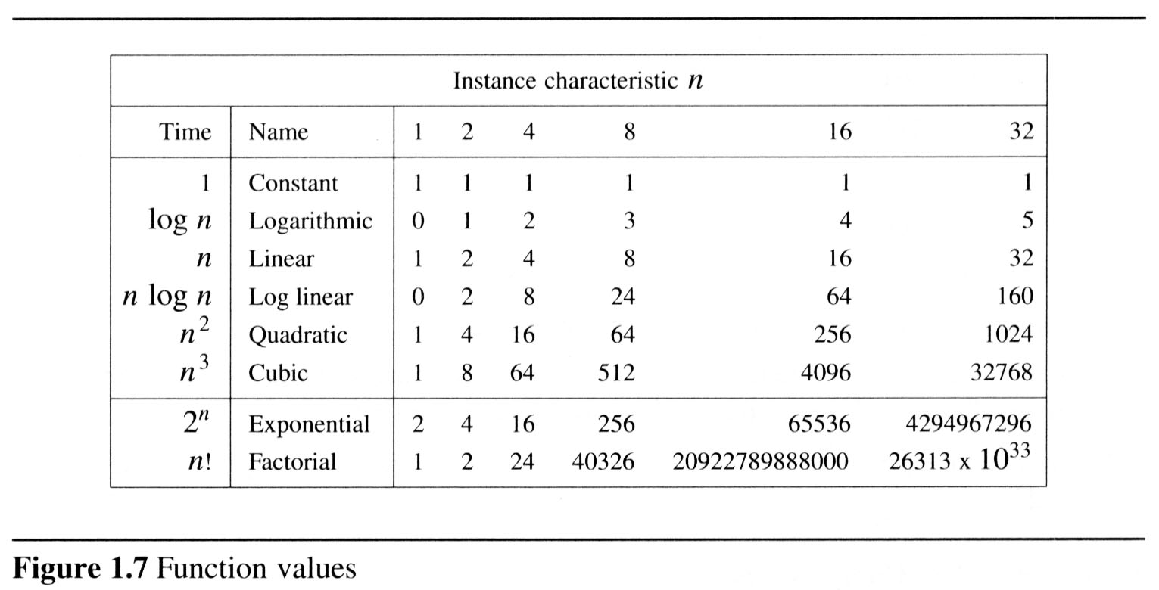
  To get a feel for how the various functions grow with n, you are advised to study the following figs:
Yogi Reddy M, Asst. Prof

Slide 75
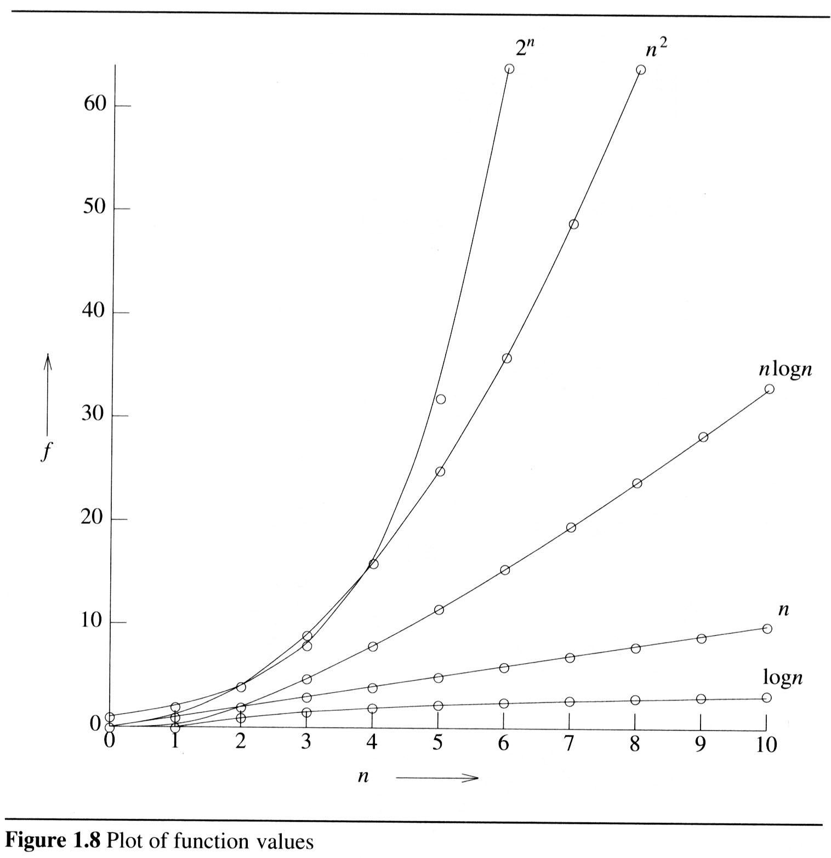
2
Yogi Reddy M, Asst. Prof

Slide 76
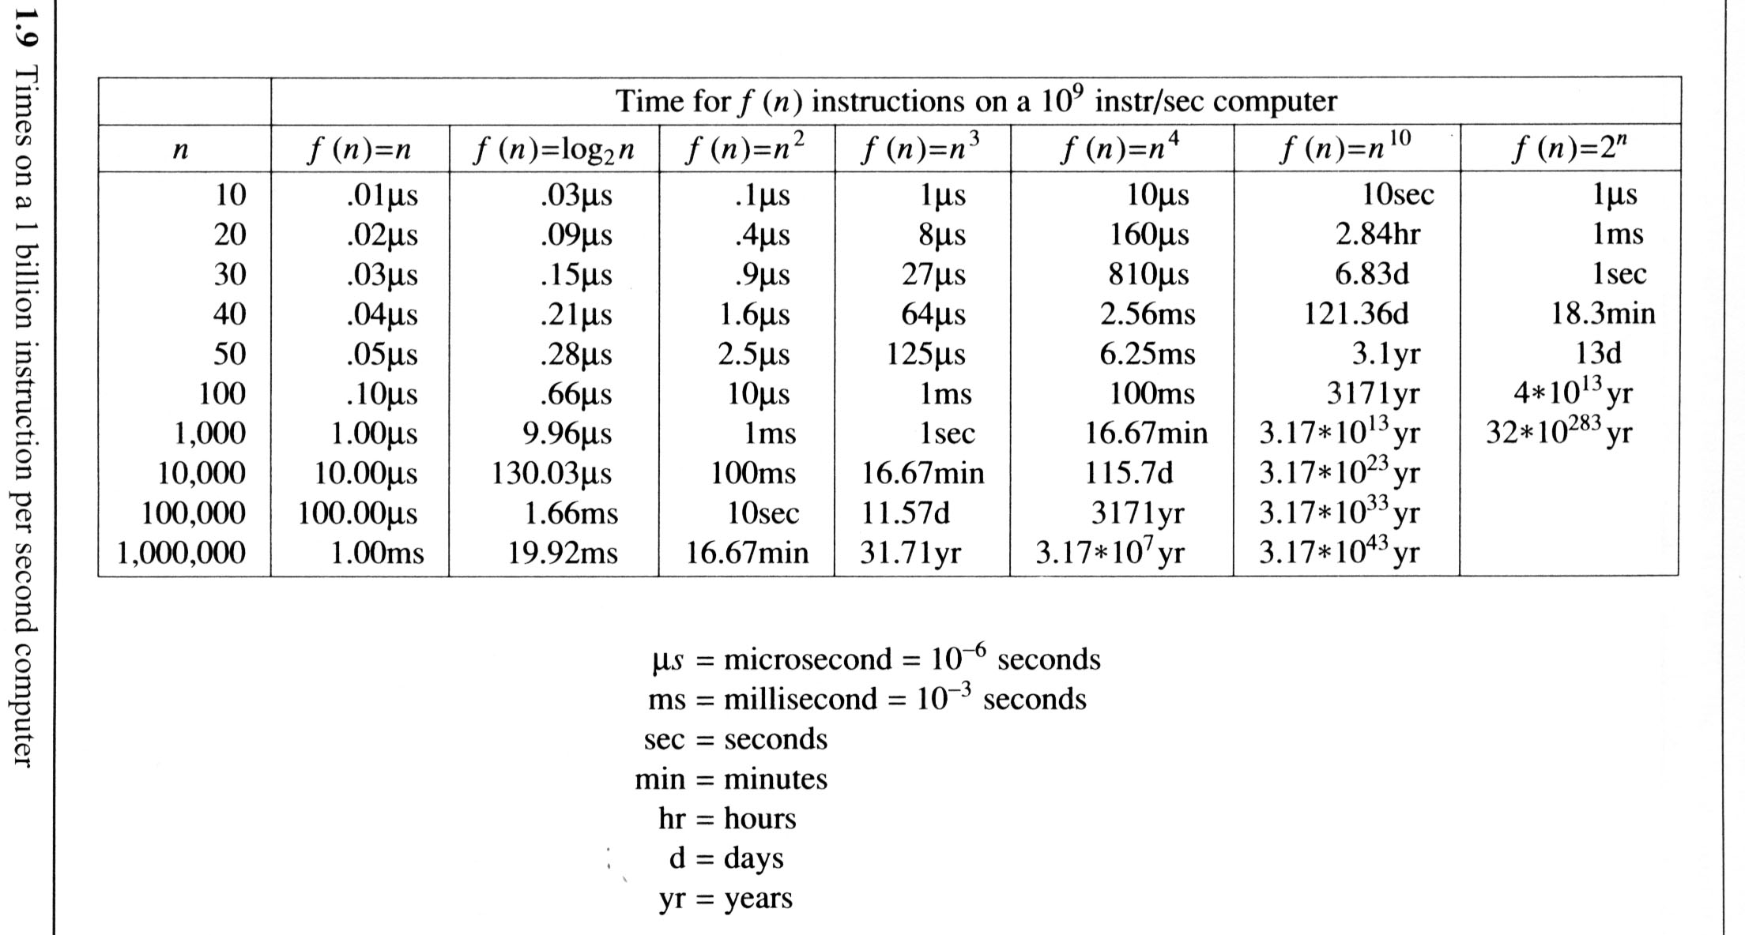
The following fig gives the time needed by a 1 billion instructions per second computer to execute a program of complexity f(n) instructions.
Yogi Reddy M, Asst. Prof

Slide 77


PAGE <number>
Yogi Reddy M, Asst. Prof

